Slide 1
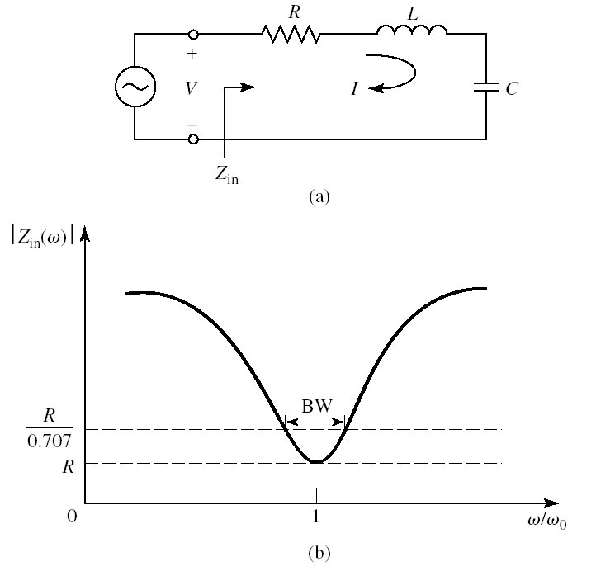
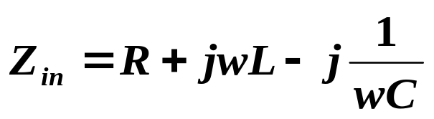
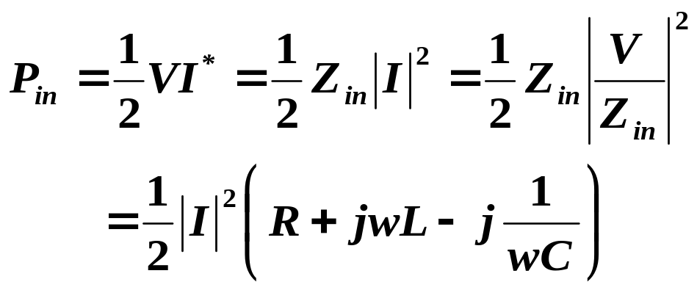
Chap. 6 Microwave Resonators
§6.1 Series and parallel resonant circuits
Near resonance, a microwave resonator can usually be modeled by either a series or parallel RLC lumped-element equivalent circuit
1. Series Resonant Circuit

Slide 2
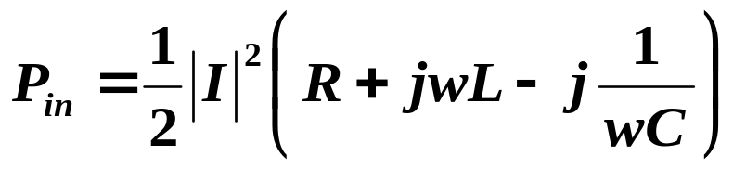
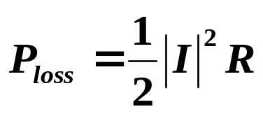
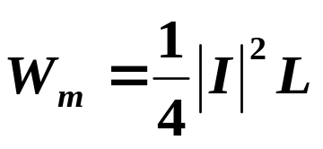
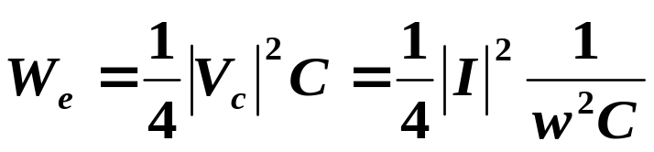
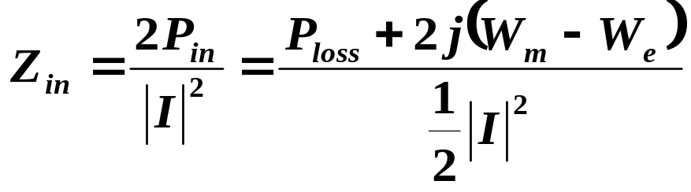
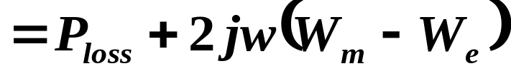
§6.1 Series and parallel resonant circuits
The power dissipated by the resistor, R, is
The average magnetic energy stored in the inductor, L, is
The average electric energy stored in the capacitor, C, is

Slide 3
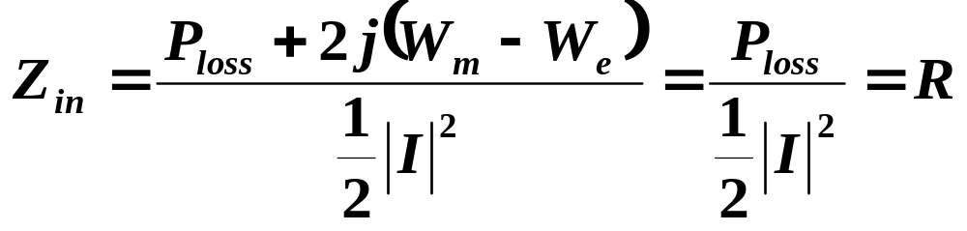
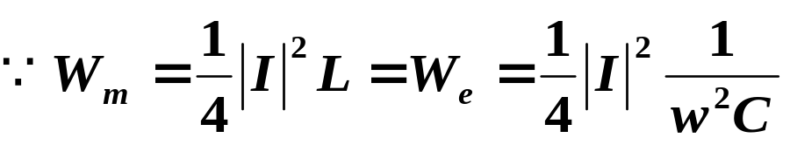
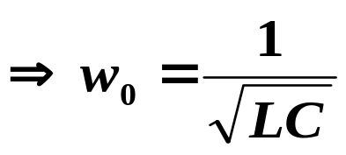
§6.1 Series and parallel resonant circuits
Resonance occurs when the average stored magnetic and electric energies are equal, thus
Equivalent resonant resistance
resistance R is usually only an equivalent resistance that accounts for the power loss in the inductor L and capacitor C and possibly the power extracted from the resonant system by some external load coupled to the resonant circuit
Resonance frequency

Slide 4
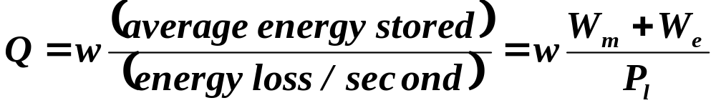
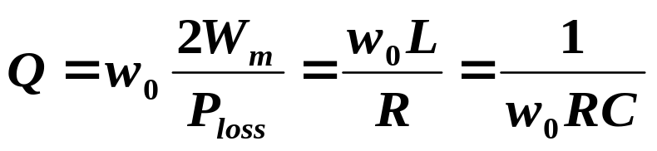

§6.1 Series and parallel resonant circuits
Q, quality factor,
  A measure of the loss of a resonant circuit
  Lower loss implies a higher Q
For the series resonant circuit

Slide 5
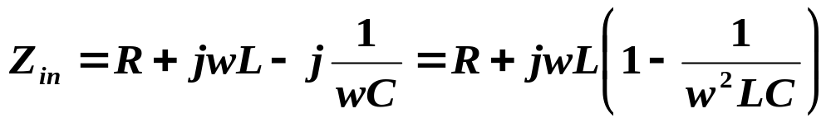
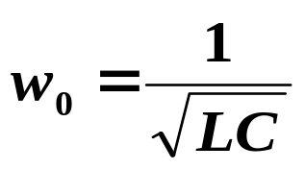
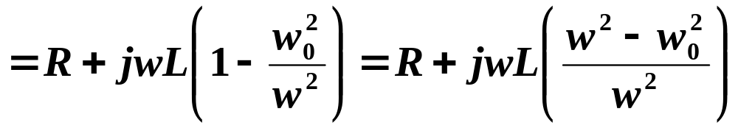
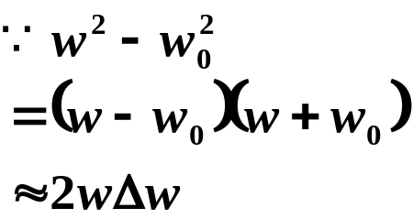

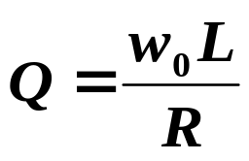
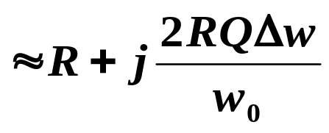
§6.1 Series and parallel resonant circuits
The behavior of the input impedance of this resonator near its resonant frequency can be shown as:

Slide 6
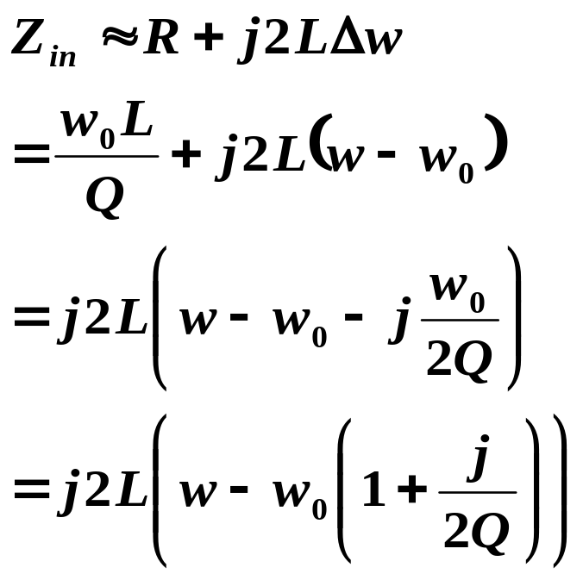
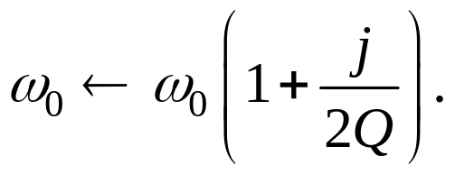

§6.1 Series and parallel resonant circuits
A series resonator with loss can be modeled as a lossless resonator
ω₀ is replaced with a complex effective resonant frequency
Then Zin can be shown as

Slide 7
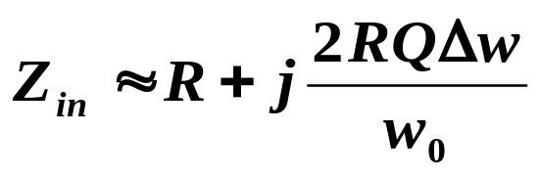
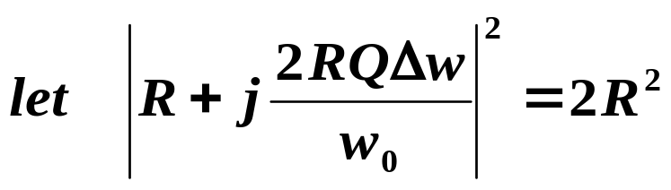
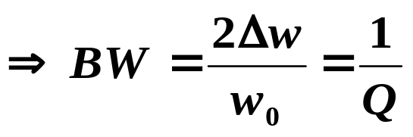
§6.1 Series and parallel resonant circuits
The half-power fractional bandwidth of the resonator
When the frequency is such that |Zin|²=2R², then the average power delivered to the circuit is one-half that delivered at resonance

Slide 8
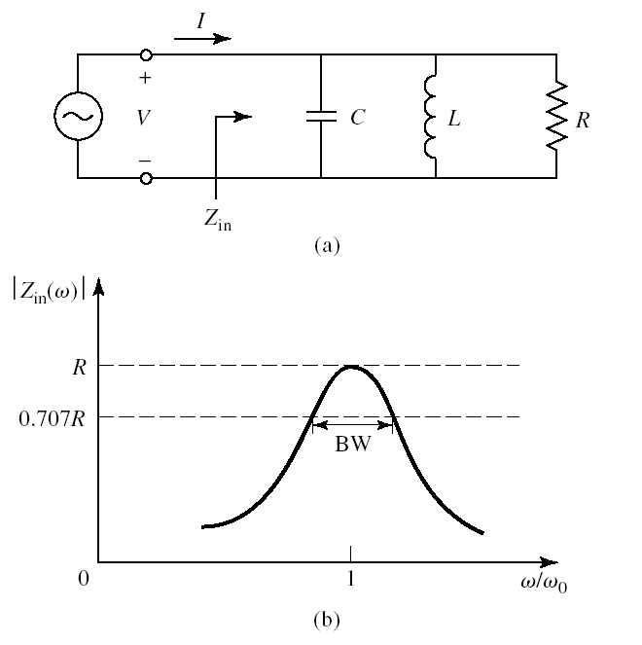
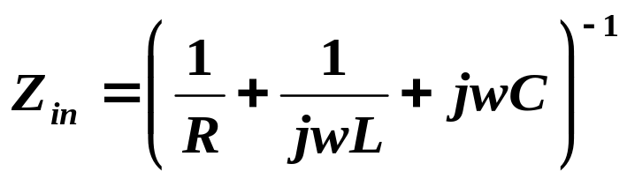
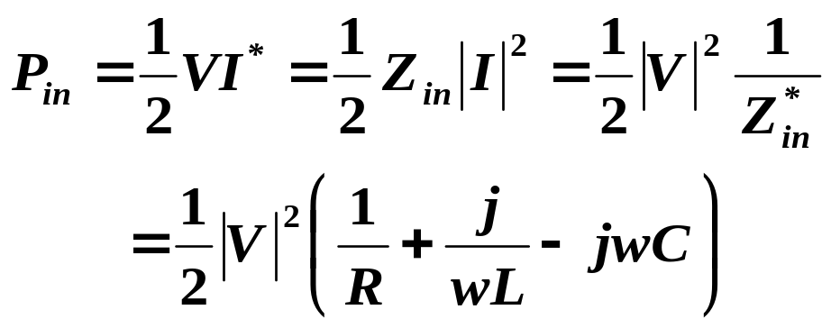
§6.1 Series and parallel resonant circuits
2. Parallel Resonant Circuit

Slide 9
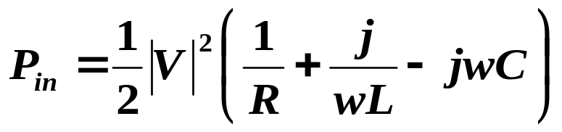
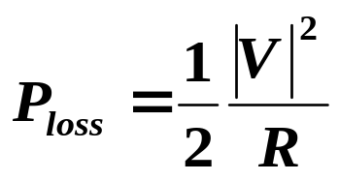
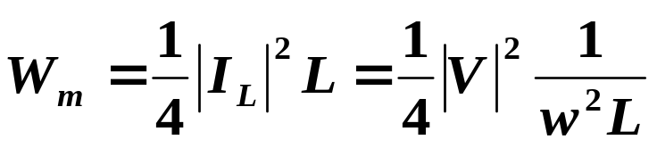
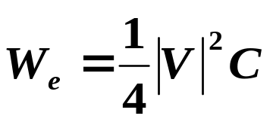

§6.1 Series and parallel resonant circuits
The power dissipated by the resistor, R, is
The average magnetic energy stored in the inductor, L, is
The average electric energy stored in the capacitor, C, is

Slide 10

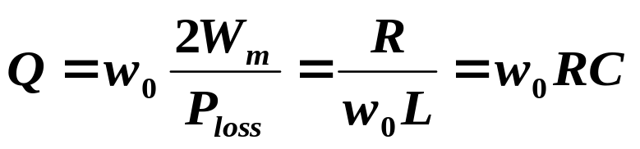

§6.1 Series and parallel resonant circuits
Resonance occurs when the average stored magnetic and electric energies are equal, thus
Equivalent resonant resistance
a purely real impedance
Resonance frequency
Q, quality factor

Slide 11

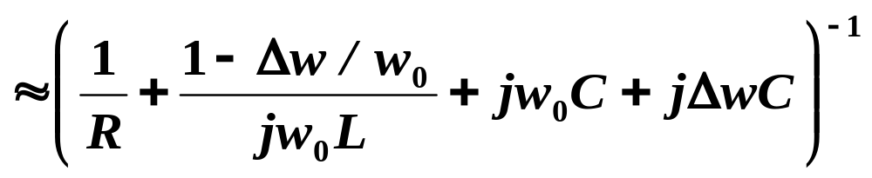
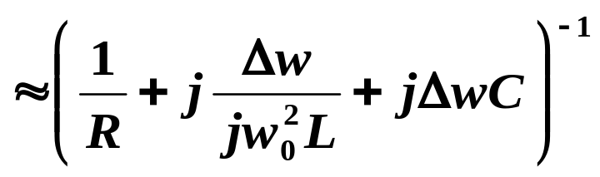
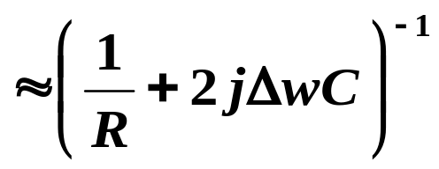
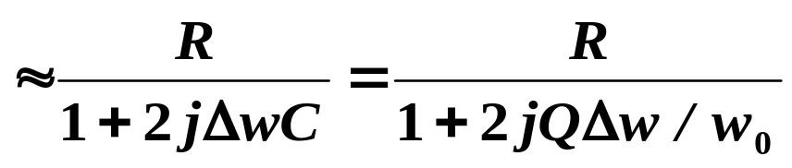
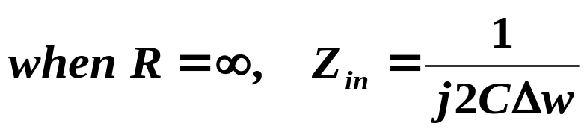
§6.1 Series and parallel resonant circuits
The input impedance of this resonator near its resonant frequency can be shown as:

Slide 12
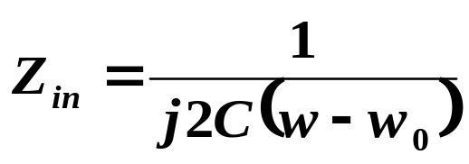
§6.1 Series and parallel resonant circuits
A parallel resonator with loss can be modeled as a lossless resonator
ω₀ is replaced with a complex effective resonant frequency
Then Zin can be shown as

Slide 13
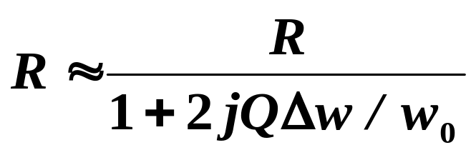
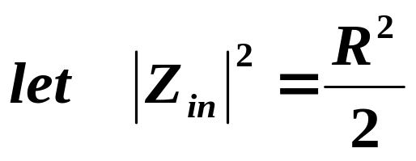
§6.1 Series and parallel resonant circuits
The half-power fractional bandwidth of the resonator

Slide 14
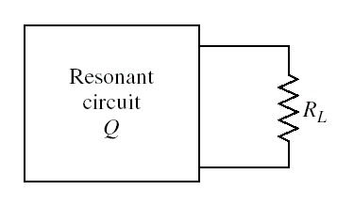
§6.1 Series and parallel resonant circuits
3. Loaded and Unloaded Q
Unloaded quality factor Q
A loaded quality factor Q_{L}
The effective resistance is the combination of R and the load resistor R_{L}.

Slide 15
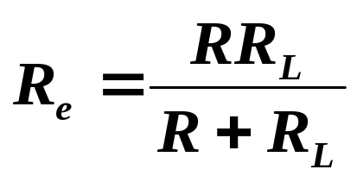
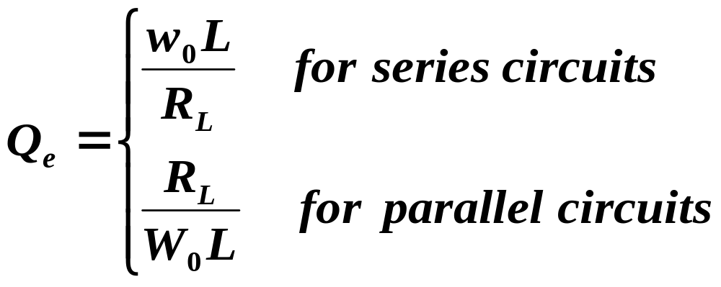
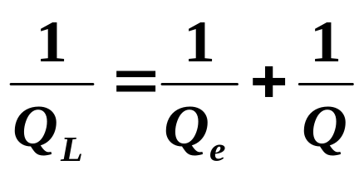
§6.1 Series and parallel resonant circuits
If the resonator is a parallel RLC circuit
External quality factor Qe
Loaded quality factor Q_{L}

Slide 16
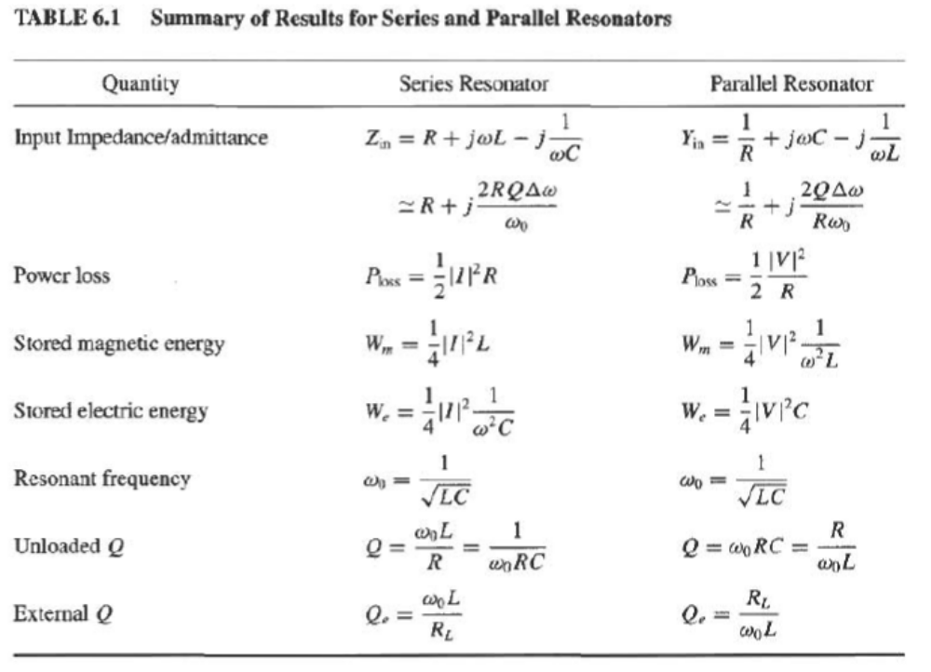
§6.1 Series and parallel resonant circuits

Slide 17
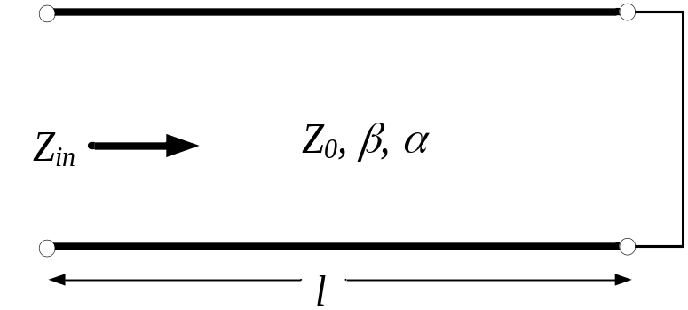
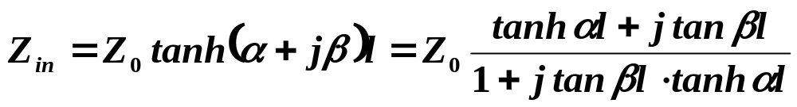
§6.2 Transmission line resonators
1. Short Circuited λ/2 Line
At the frequency w=w₀, the length of the line is l=λ/2
Notes:
hyperbolic tangent 双曲正切

Slide 18
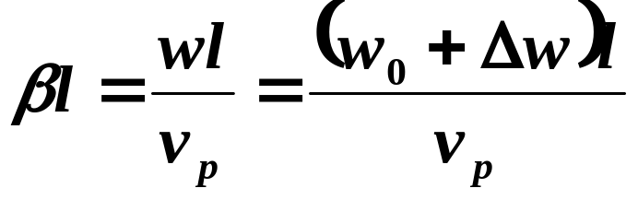
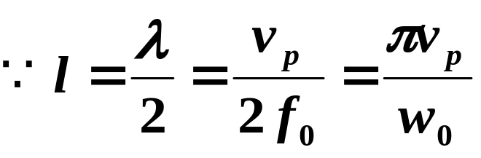



§6.2 Transmission line resonators
For a small loss TL, we can assume αl << 1 so tanαl ≈ αl. Now let ω = ω0+ Δω, where Δω is small. Then, assume a TEM line,

Slide 19







§6.2 Transmission line resonators
For a series RLC resonant circuit
The resonator resonates for
Δω = 0 (l = λ/2) and its input impedance is
Resonance occurs for l =n λ/2, n=1,2,3…
The Q of this resonator can be found as

Slide 20


§6.2 Transmission line resonators
A short-circuited length of lossy transmission line, and the voltage distributions for n = 1 resonators.

Slide 21



§6.2 Transmission line resonators
Example 6.1 Q of half-wave coaxial line resonators
A λ/2 resonator is made from a piece of copper coaxial line, with an inner conductor radius of 1mm and an outcondutctor radius of 4mm. If the resonant frequency is 5GHz, compare the Q of an air-filled coaxial line resonator to that of a Teflon-filled coaxial line resontor
Solution:
For air-filled line

Slide 22




§6.2 Transmission line resonators
For Telflon, εr=2.08, tanδ=0.0004

Slide 23



§6.2 Transmission line resonators
2. Short Circuited λ/4 Line
assume that l=λ/4 at w=w₀, ant let ω = ω0+ Δω,Then for a TEM line

Slide 24







§6.2 Transmission line resonators
For a parallel RLC resonant circuit

Slide 25




§6.2 Transmission line resonators
3. Open-Circuited λ/2 Line
A practical resonator that is often used in microstrip circuits consists of an open-circuited length of transmission line
Such a resonator will behave as a parallel resonant circuit when the length is nλ/2
assume that l=λ/2 at w=w₀, ant let ω = ω0+ Δω, then

Slide 26



§6.2 Transmission line resonators
For a parallel RLC resonant circuit

Slide 27



§6.2 Transmission line resonators
Example 6.1 a half-wave microstrip resonator
consider a microstrip resonator constructed from a λ/2 length of 50Ω open-circuited microstrip line. The substrate is Teflon(εr=2.08, tanδ=0.0004), with a thickness of 0.159cm. The conductors are copper. Compute the length of the line for resoance at 5GHz, and the Q of the resonator. Ignore fringing fields at the end of the line
Solution:
The width of a 50 Ω microstrip line on this substrate is found to be
The effective permittivity is
resonant length:

Slide 28




§6.2 Transmission line resonators

Slide 29






§6.2 Transmission line resonators
Ee^{j(ϕ＋2βl+θ1+θ2)}
Ee^{jϕ}
Resonant conditions
Resonant frequency
non dispersive wave:
Dispersive wave

